Slide 1
Latest Developments on HKO's Tropical Cyclone Warning Services
Hong Kong, China
Jennifer Yip
Scientific Officer
Hong Kong Observatory

Slide 2
Content
Tropical Cyclone Reconnaissance Flights
1
ResConvLSTM-GAN -- Deep Learning Model for Radar and Satellite Nowcast
2
AI-STORMVIS -- AI Satellite-based TC Object Recognition, Motion Visualization, and Intensity Estimation System
3
Probabilistic Storm Surge Forecast
4

Slide 3
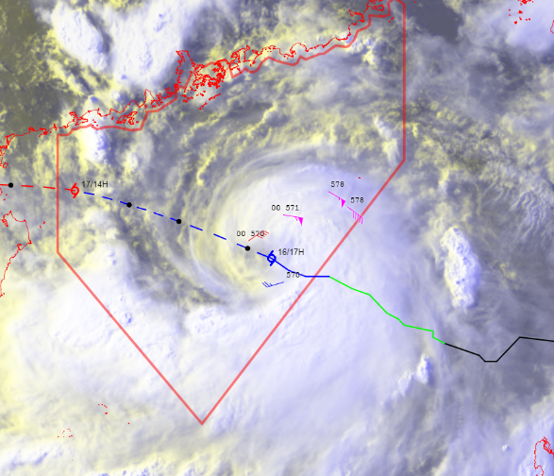
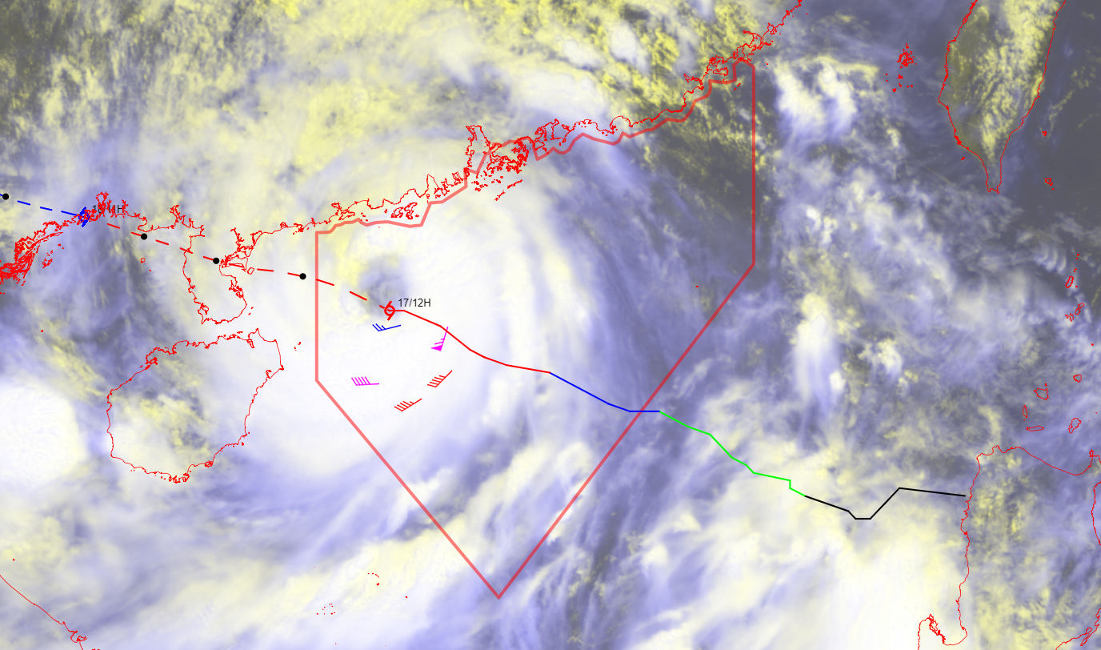
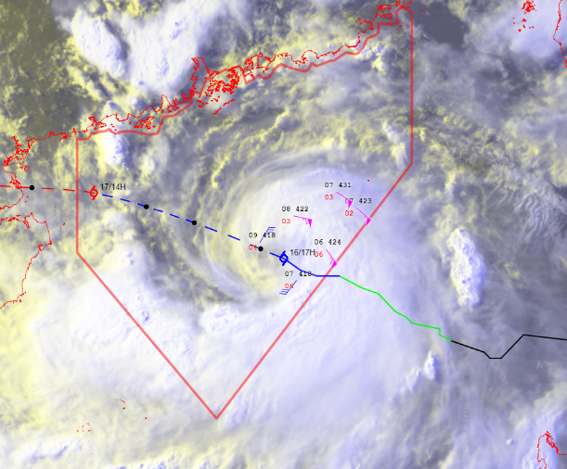
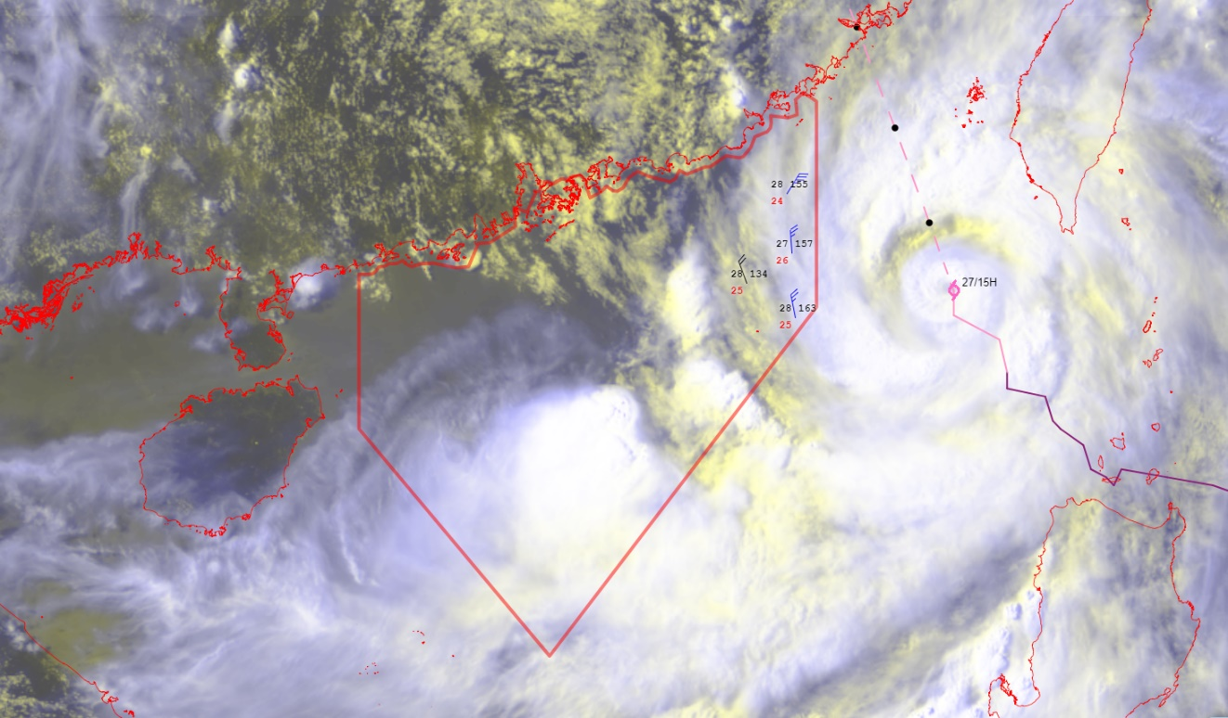
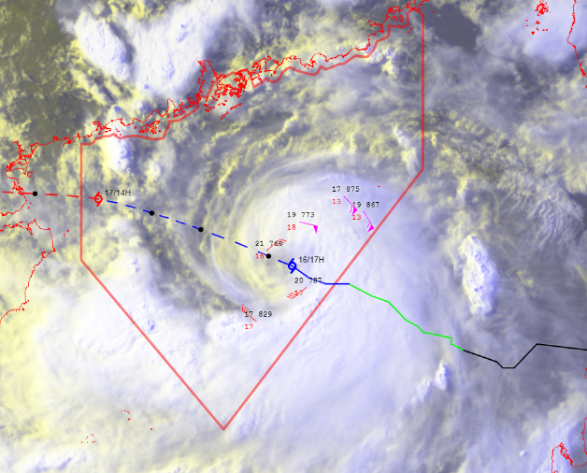
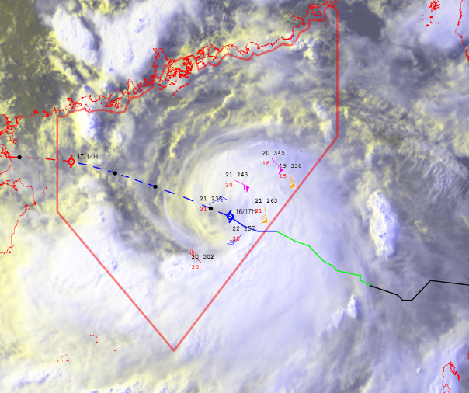
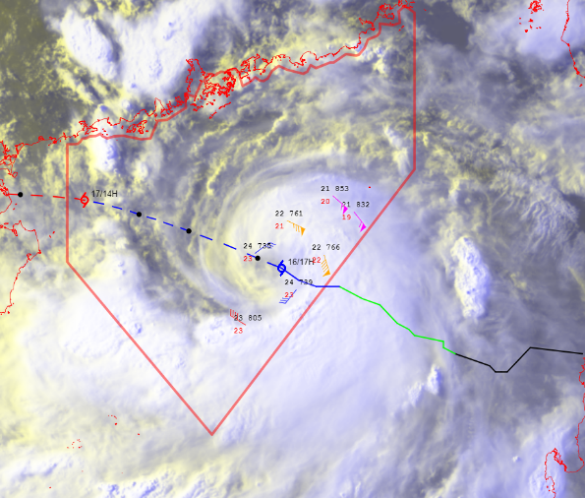
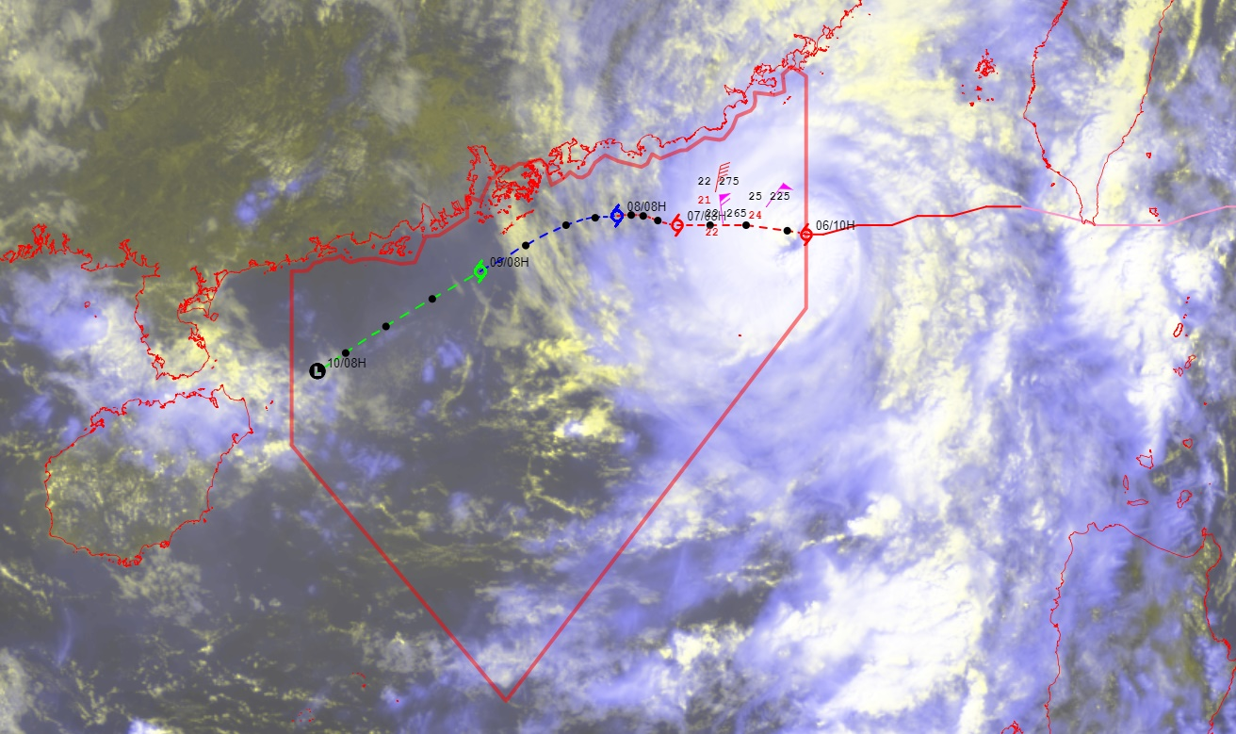
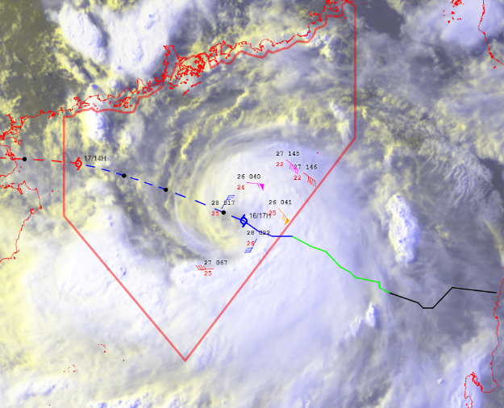
500hPa
TC Talim
16/07 17H
Talim
17/07 12H
Tropical Cyclone
Reconnaissance Flights
8 dropsonde missions in 2023 up until October
Talim (15, 16 and 17 July)
Doksuri (27 July morning and afternoon)
Saola (31 August)
Koinu (6 October morning and night).
The quality-controlled data are converted to BUFR format and disseminated via GTS to facilitate subjective analysis by forecasters as well as data assimilation into NWP models.
600hPa
Doksuri
27/07 15H
700hPa
800hPa
3
850hPa
900hPa
Koinu
06/10 10H
Saola
01/09
975hPa

Slide 4
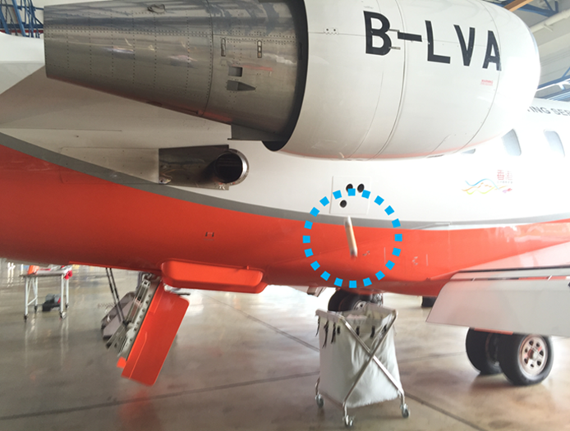
Dropsonde Flights
AVAPS-II system installed on Challenger 605, a fixed-wing aircraft, of Hong Kong Government Flight Service (GFS)
A typical dropsonde flight will release roughly 10-15 sondes within the Hong Kong Flight Information Region (FIR) in northern South China Sea, with each flight lasting about 3 hours.

Slide 5
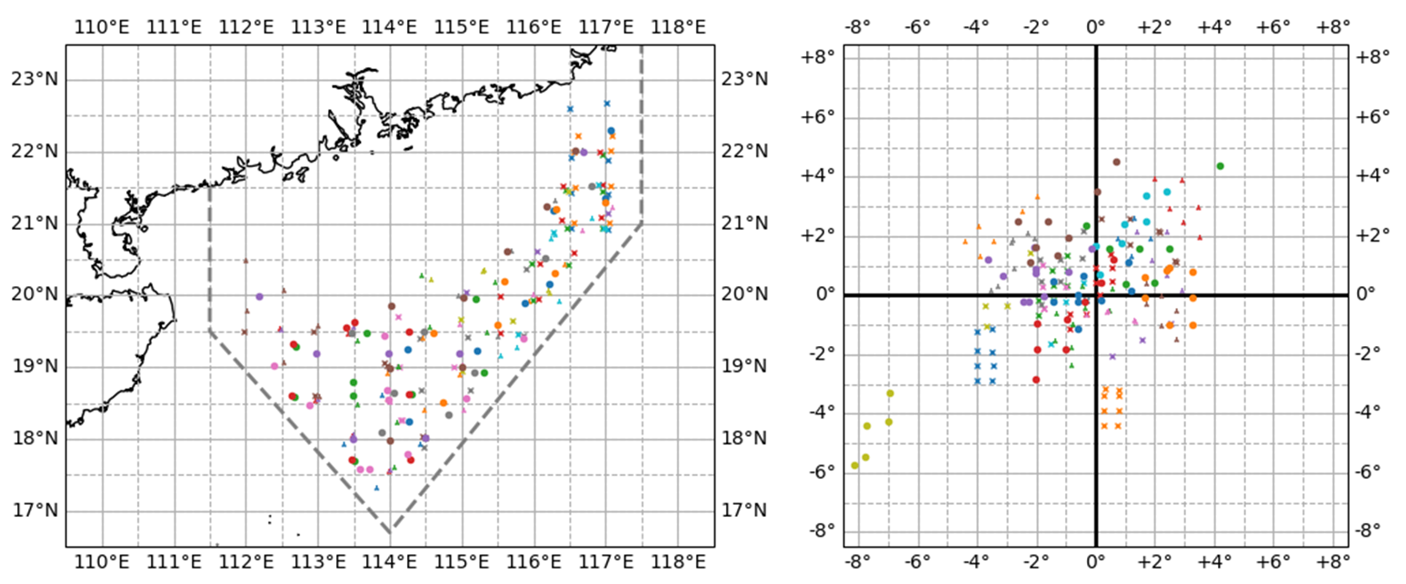
Dropsonde data in 2016-2020
Observation position relative to center of tropical cyclone
~150 nautical miles offshore
A total of about 190 soundings in 28 missions
HKFIR

Slide 6
Content
Tropical Cyclone Reconnaissance Flights
1
ResConvLSTM-GAN -- Deep Learning Model for Radar and Satellite Nowcast
2
AI-STORMVIS -- AI Satellite-based TC Object Recognition, Motion Visualization, and Intensity Estimation System
3
Probabilistic Storm Surge Forecast
4

Slide 7
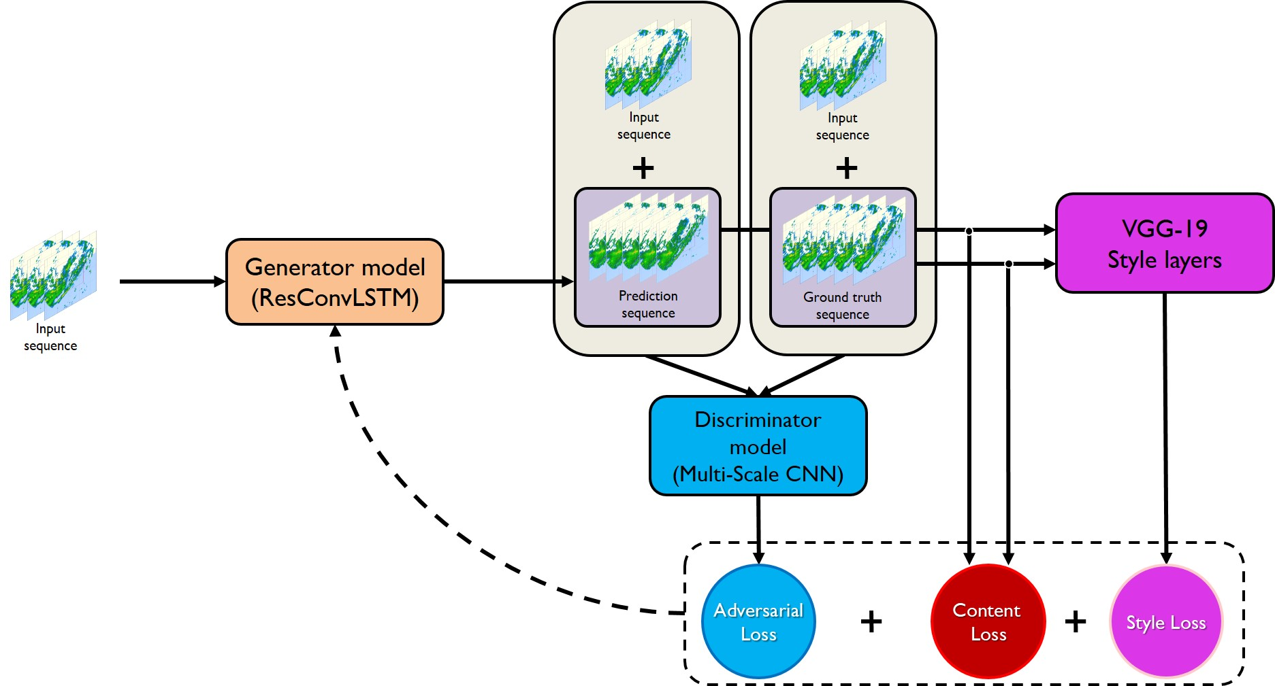
ResConvLSTM-GAN
A new deep learning model for radar and satellite nowcast using generative adversarial network
Developed by HKO
ResConvLSTM-GAN enhances the ConvLSTM module using residual connections, the generative adversarial network (GAN) pipeline, style transfer technique, and a dynamically balanced loss function
ConvLSTM with residual connections in encoder-forecaster network
Generative Adversarial Network (GAN) to improve representation of small-scale features
Architecture of ResConvLSTM-GAN
Discriminator Model - Loss Components
$α$1 Adversarial Loss:
Predicted Label vs Actual Label
Aim : To generate output similar to the actual radar sequence
$α$2 Content Loss:
Balanced-MAE-MSE Loss
Aim : To generate accurate radar nowcast
$α$3 Style Loss:
Neural Network-based loss
Aim : To mimic style of spatial features from input radar sequence

Slide 8
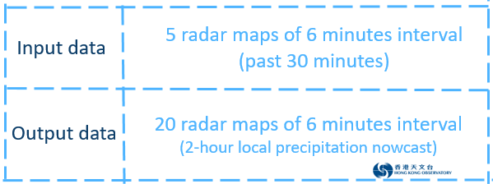
ResConvLSTM-GAN
on Radar Reflectivity Data
ResConvLSTM-GAN
Optical Flow
Actual Observations
TrajGRU
ConvLSTM

Slide 9
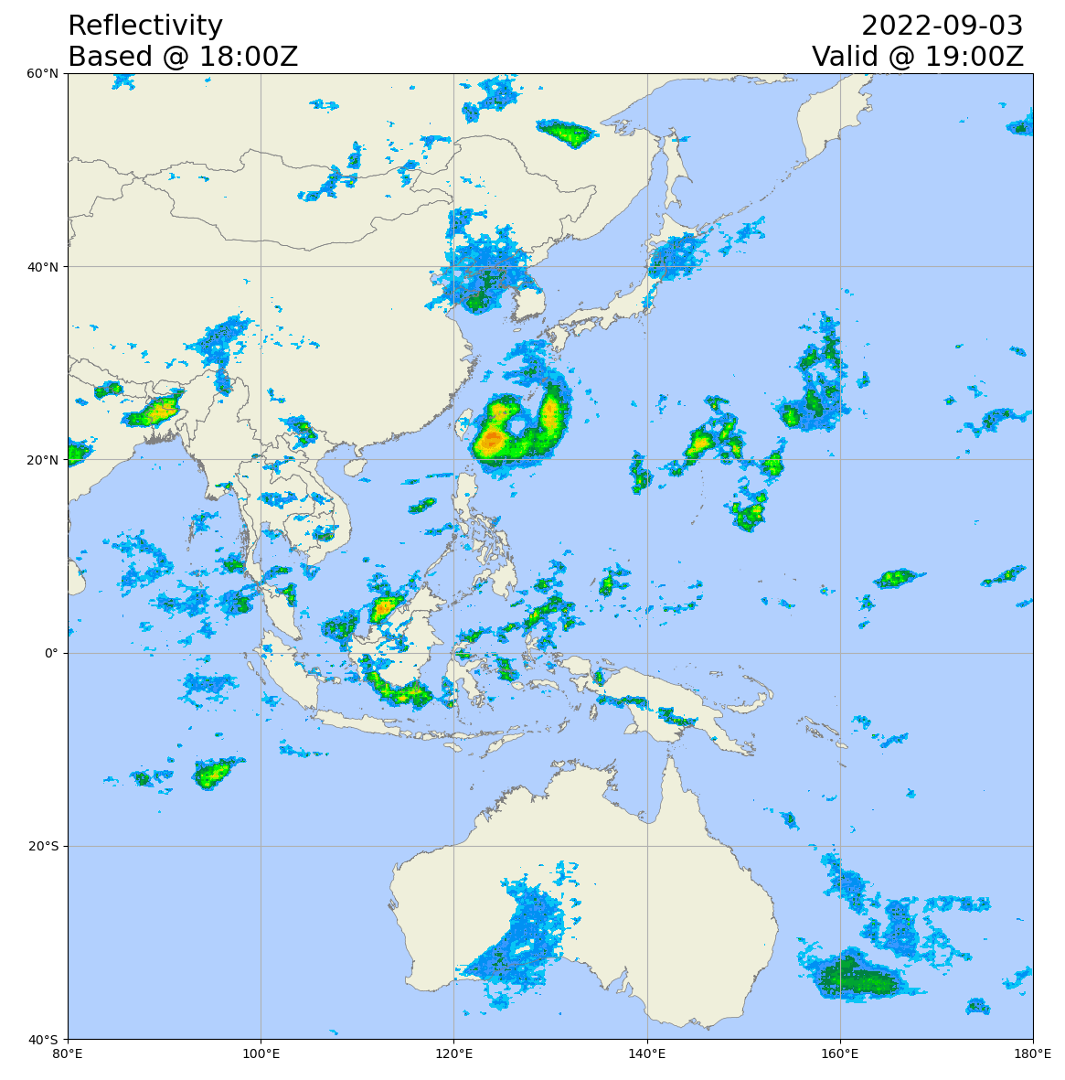
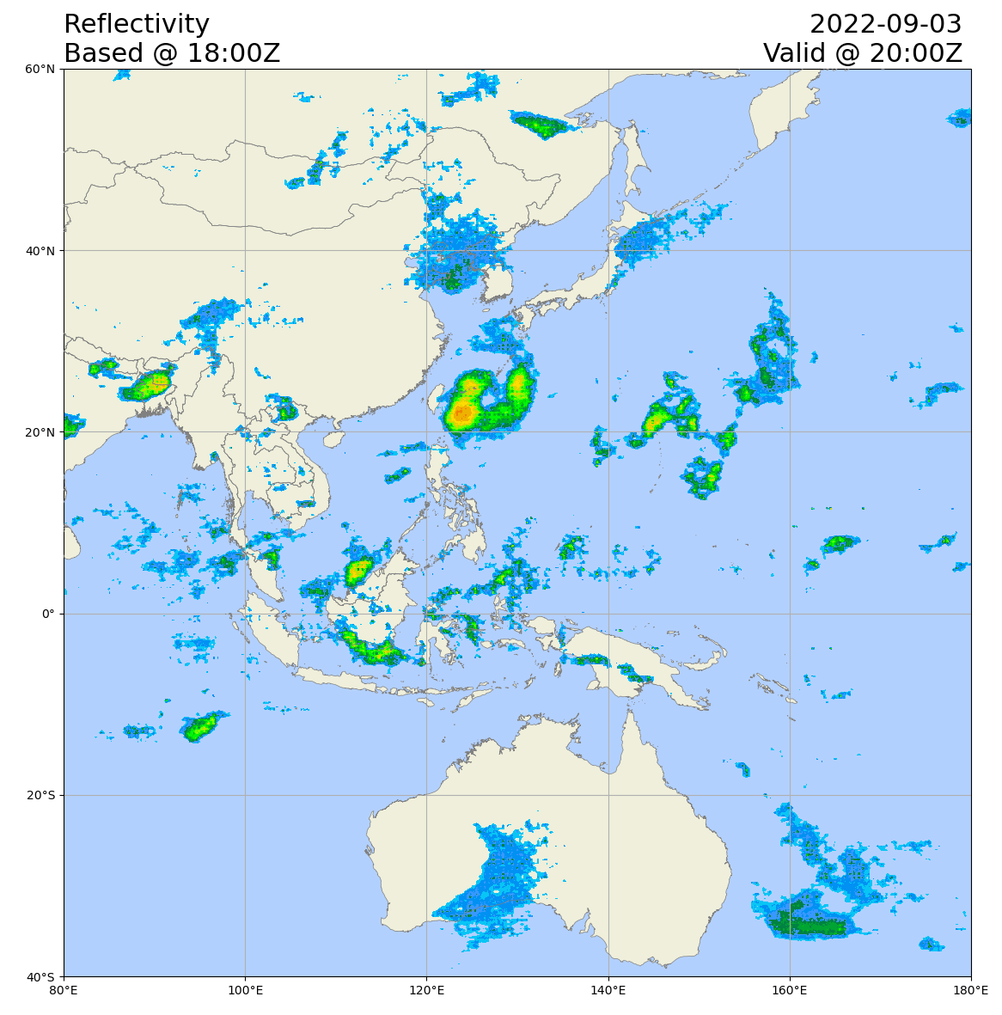
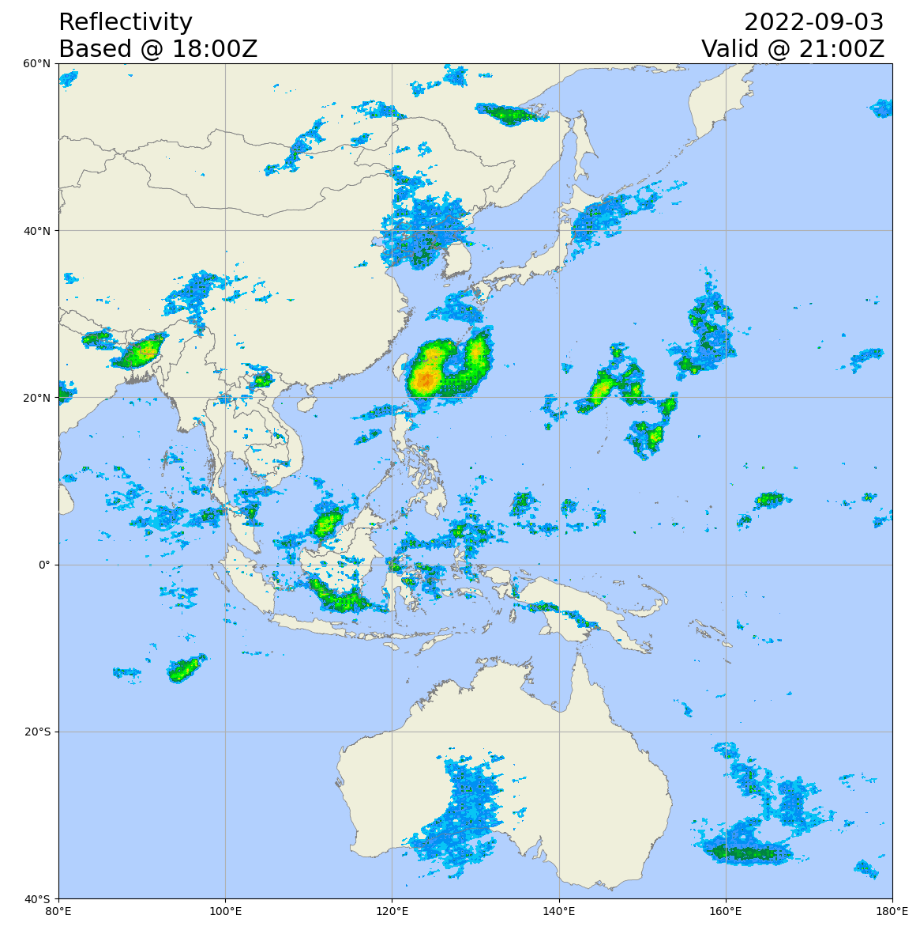
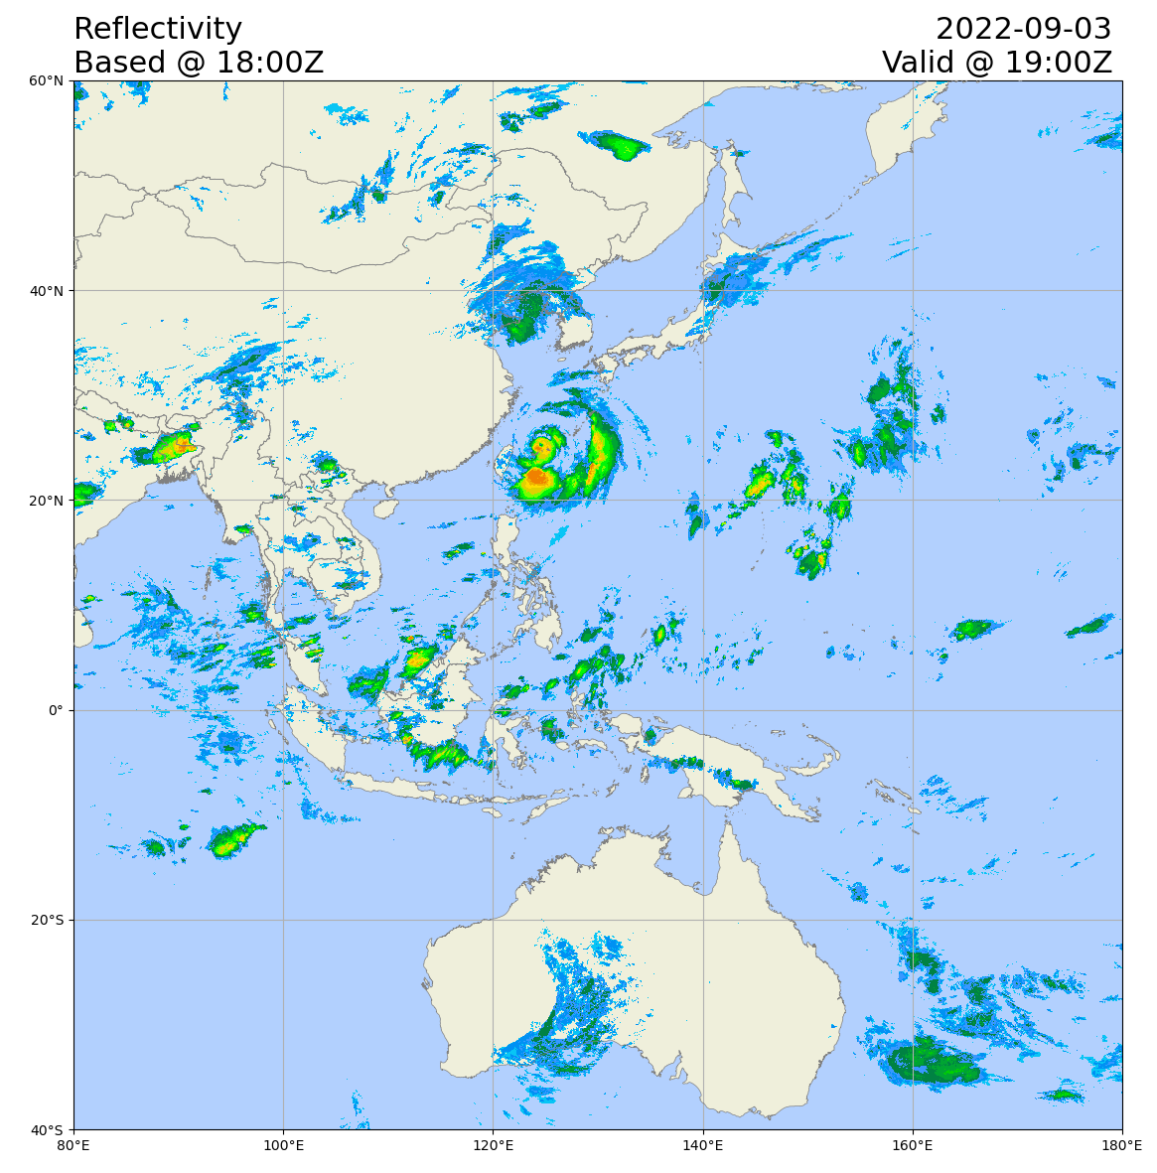
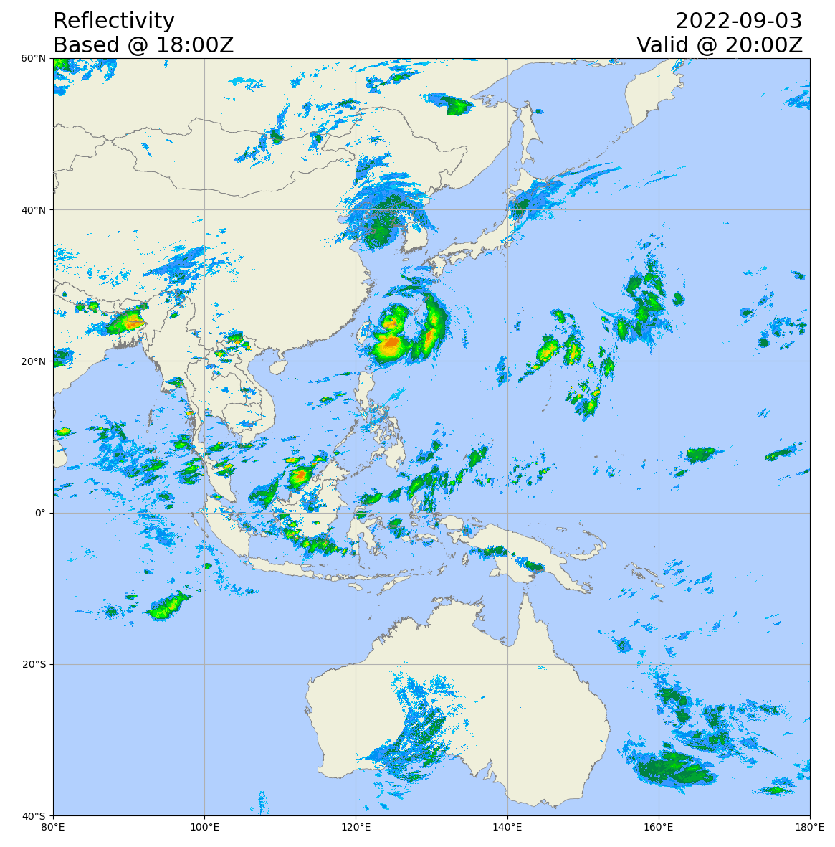
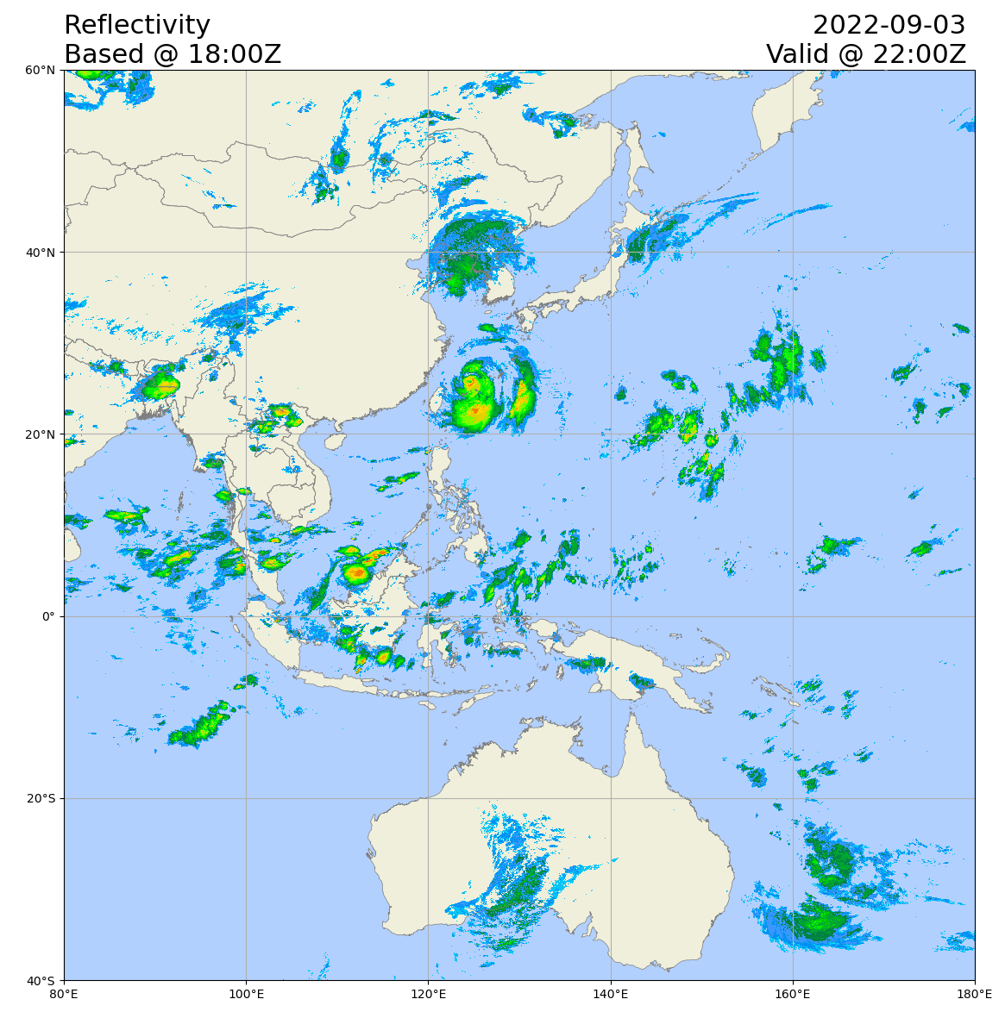
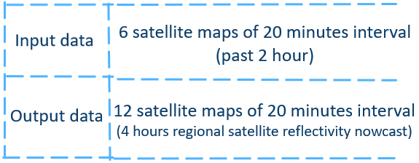
ResConvLSTM-GAN On Satellite Nowcast – Tropical Cyclone Hinnamnor
Actual Observations
ResConvLSTM-GAN
Uses geostationary satellite imagery
Enhances rainfall or significant convection nowcasts over an extensive geographical coverage for the next four hours.

Slide 10
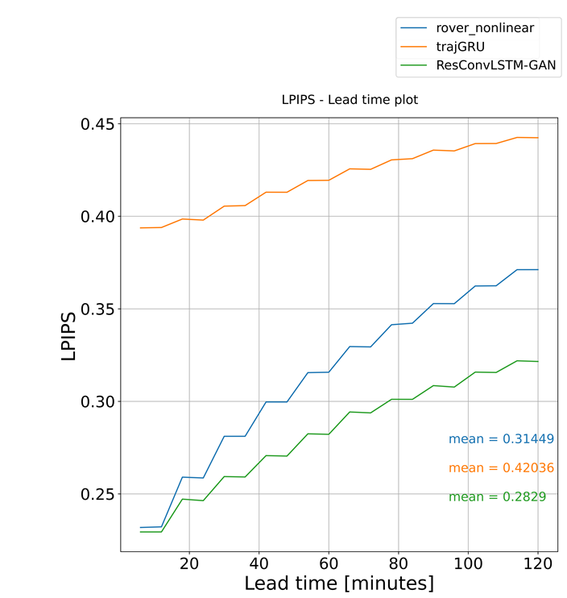
A New Deep Learning Model for Radar and Satellite Nowcast using Generative Adversarial Network
More accurate and realistic nowcasts as compared to ROVER and TrajGRU (verified using 2021 data)
Trial operation in HKO since early 2023
Next steps: Expand geographical coverage of radar nowcasts Extend duration of satellite nowcast from 4 hours to up to 9 hours
ResConvLSTM would be deployed to the website of RSMC for Nowcasting, providing real-time nowcasting information for other NMHSs in Asia.
Learned Perceptual Patch Similarity (LPIPS) of Radar Nowcast (Lower the better)
The Critical Success Index (CSI) of Radar Nowcast generated by the three methods

Slide 11
Content
Tropical Cyclone Reconnaissance Flights
1
ResConvLSTM-GAN -- Deep Learning Model for Radar and Satellite Nowcast
2
AI-STORMVIS -- AI Satellite-based TC Object Recognition, Motion Visualization, and Intensity Estimation System
3
Probabilistic Storm Surge Forecast
4

Slide 12
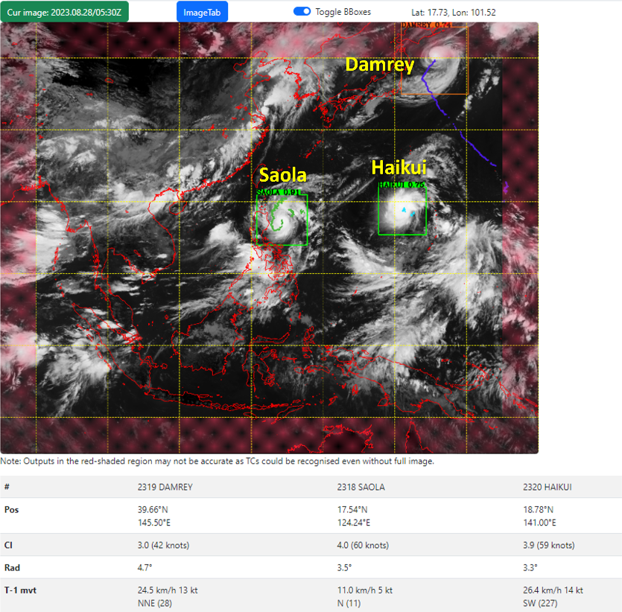
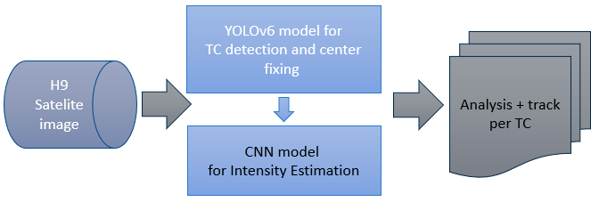
AI-STORMVIS - Automating Tropical Cyclone Position Analysis and Intensity Estimation from Satellite Images by Artificial Intelligence
AI-STORMVIS (AI-driven Satellite-based TC Object Recognition, Motion Visualization, and Intensity Estimation System)
TC position analysis
Ensemble of three pre-trained YOLOv6 object detection models
Intensity estimation
Based on Himawari-9 infrared satellite images.
Convolutional Neural Network (CNN) for current intensity (CI) estimation
Training
Satellite images and TC information from 2015 to 2021.
Service Region
15-45N, 85-160E
Also provides early indication on developing low-pressure area
or potential location of TC genesis.

Slide 13
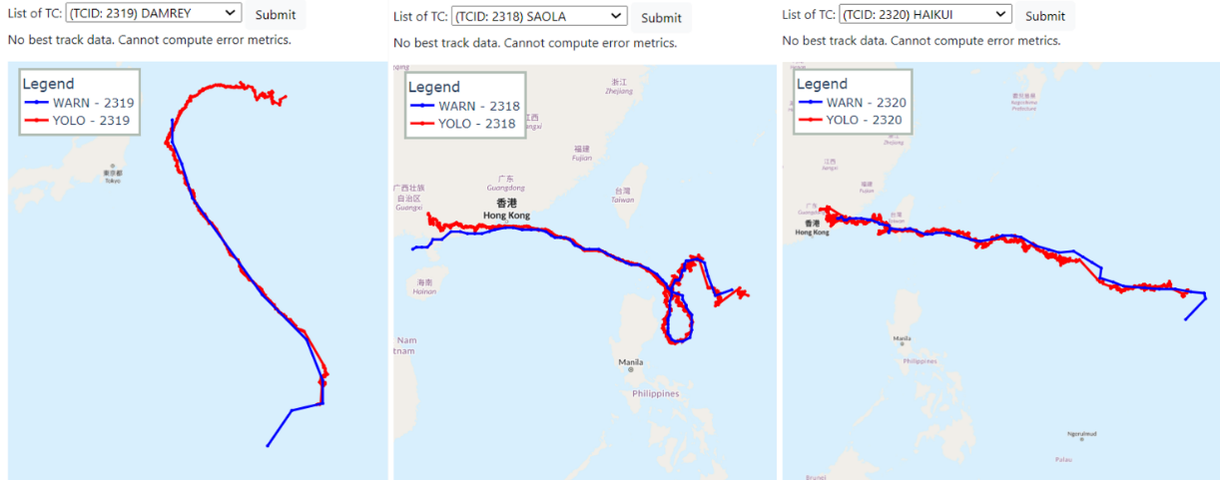

Slide 14
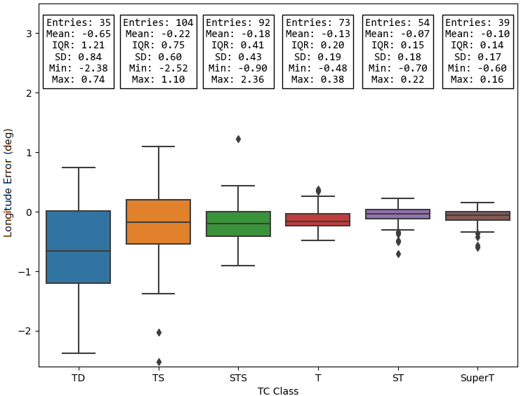
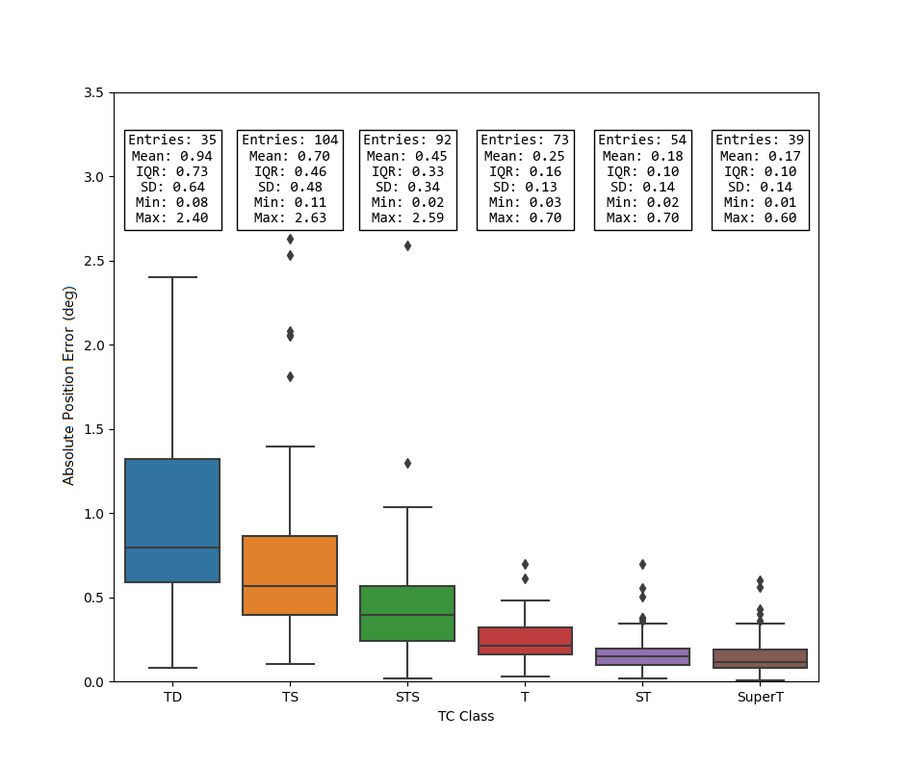
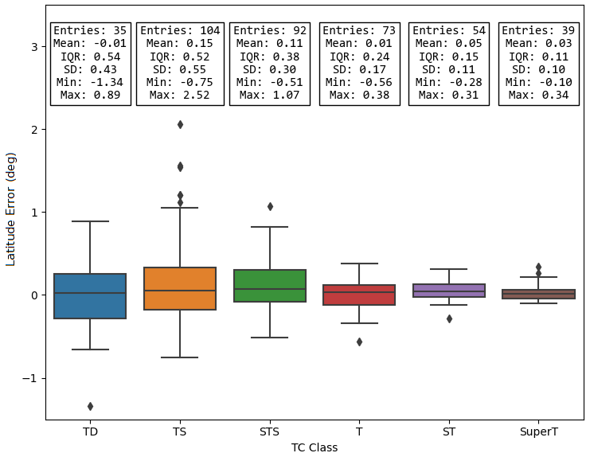
Absolute Position Error (Per TC Intensity Class)
IQR, Mean and SD decrease as intensity increases – model uncertainty decreases for stronger TCs.
ST & SuperT have lowest mAPE of 0.18°& 0.17°
TD has highest mAPE of 0.94°
Error in Longitude (Per TC Intensity Class)
Negative mLonE (especially for TD)
Uneven distribution (more –ve errors)
A left bias in longitude
Error in Latitude (Per TC Intensity Class)
Neutral mLatE
Neutral distribution
Error in latitude mainly due to up-and-down jitters

Slide 15
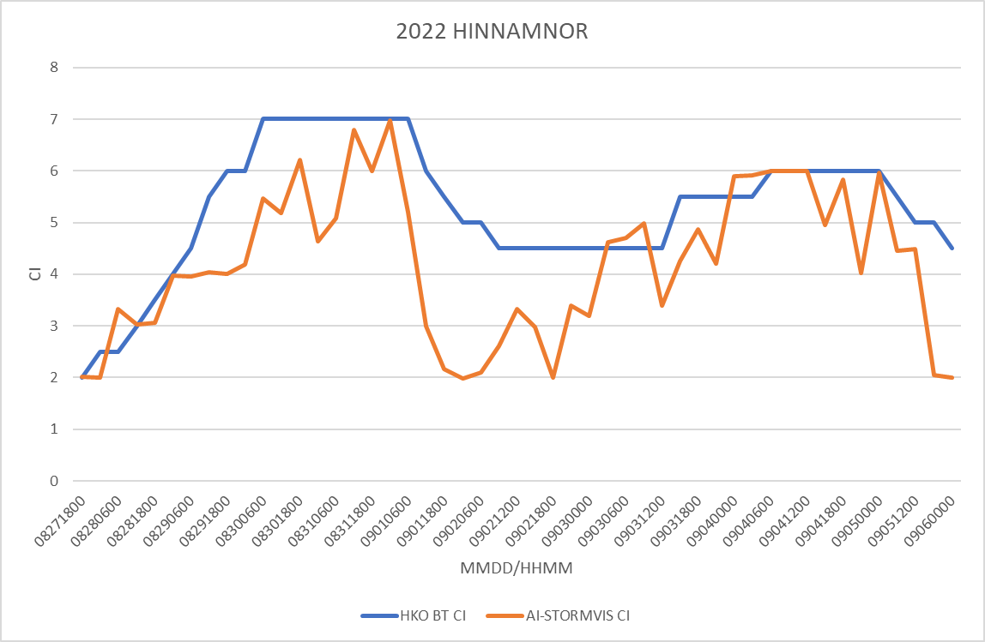
Intensity Mean Error (Per TC Intensity Class)
Median mean error of CI within 1 for all TC intensity classes
Systematic negative bias (underestimates intensity) for TS or above
Model could capture trend of TC evolution.

Slide 16
Content
Tropical Cyclone Reconnaissance Flights
1
ResConvLSTM-GAN -- Deep Learning Model for Radar and Satellite Nowcast
2
AI-STORMVIS -- AI Satellite-based TC Object Recognition, Motion Visualization, and Intensity Estimation System
3
Probabilistic Storm Surge Forecast
4

Slide 17
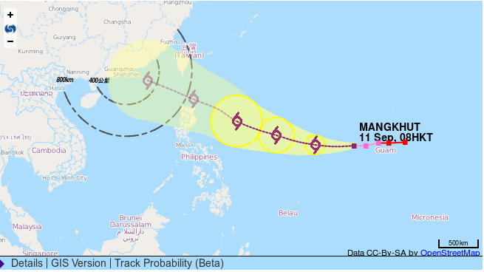
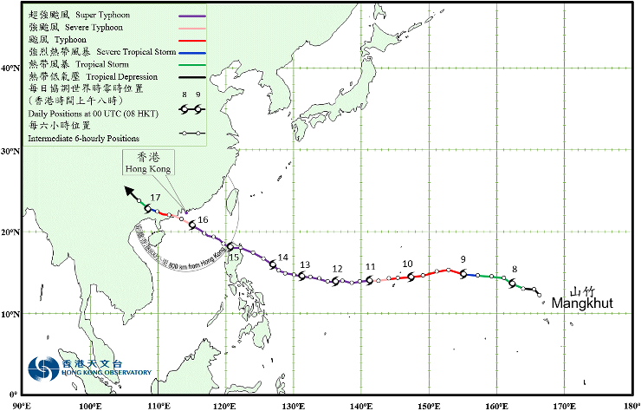
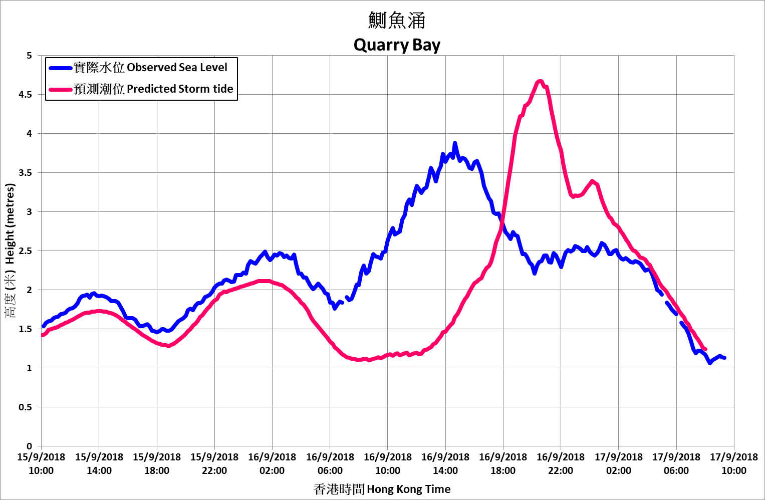
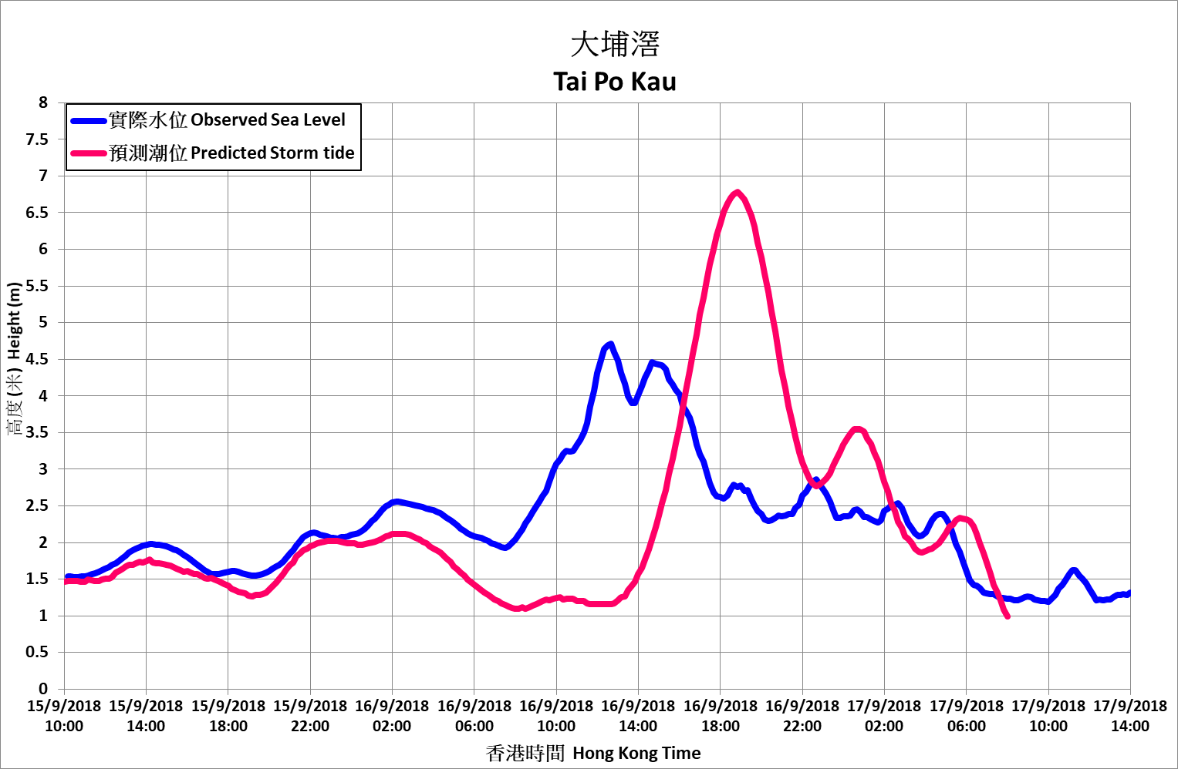
Storm Surge Probabilistic Forecast
Uncertainties in Forecast Track
Forecasted track of Mangkhut on 11 Sept, 2018
(120h before closest approach)
Actual Track of Mangkhut
The accuracy of storm surge numerical forecasts is highly sensitive to the predicted path and size of a tropical cyclone. The uncertainty associated with a single forecast path greatly affects the accuracy of storm surge forecasts.
Even slight variations in the landfall location can lead to completely different outcomes (e.g. landfall east / west of the territory)
Storm surge probability forecasts provide risk assessments to support the operation of storm surge warnings.

Slide 18
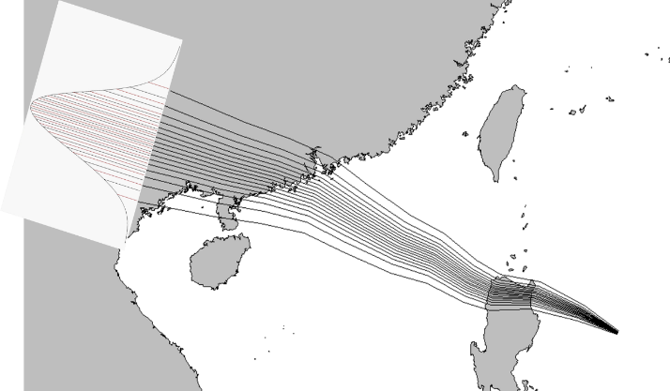
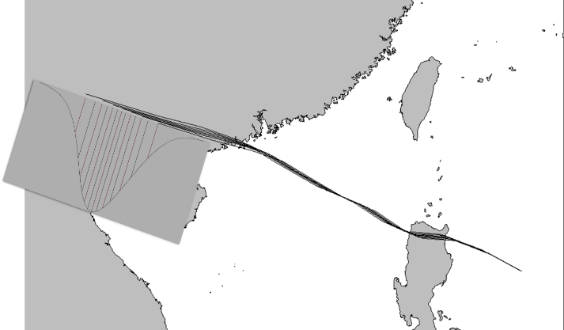
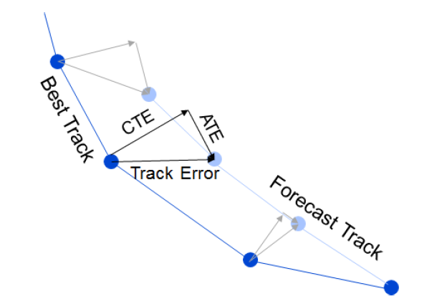
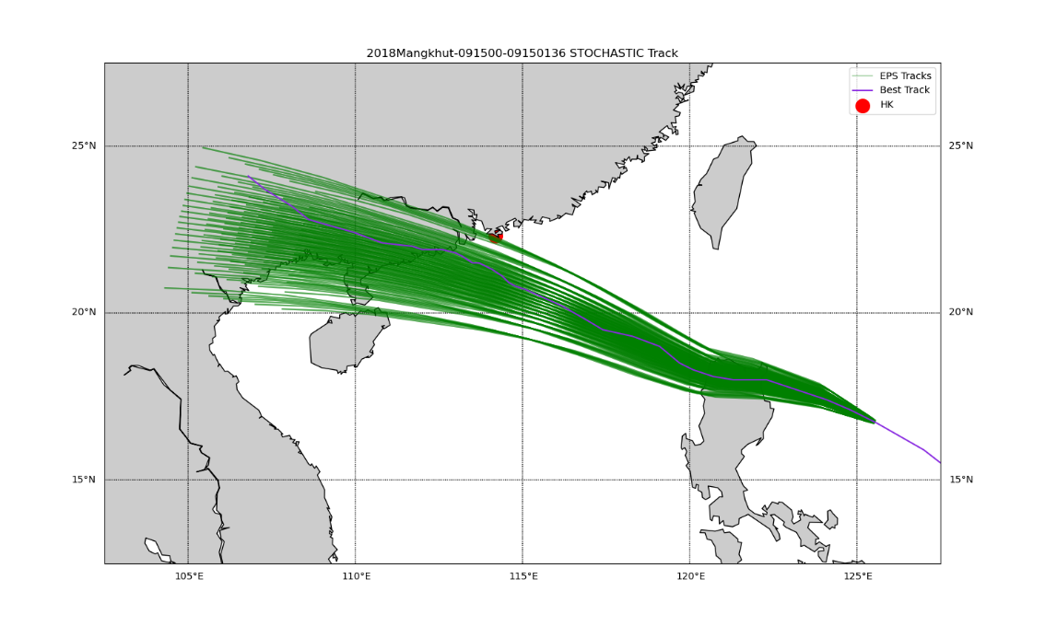
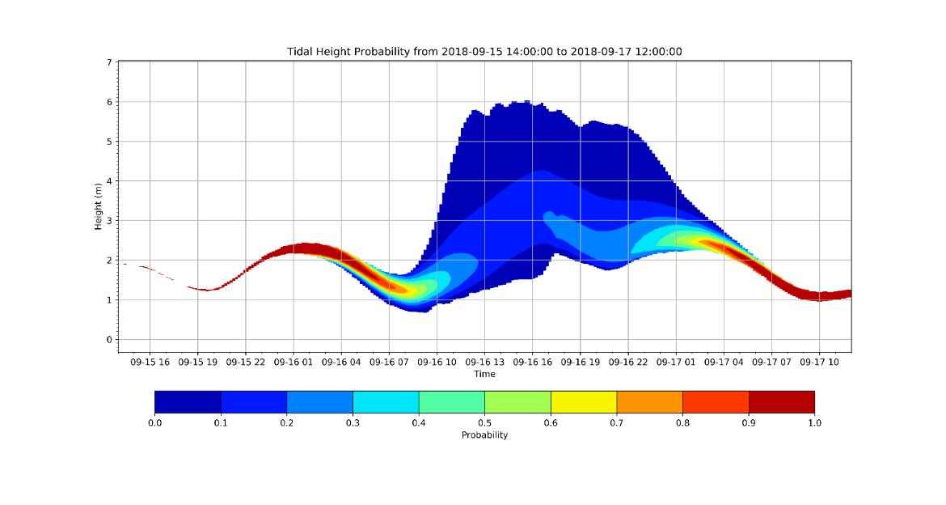
Storm Surge Probabilistic Forecast
Cross Track Error (CTE)
Along Track Error (ATE)
Stochastic Approach
Using statistical methods to generate hypothetical TC tracks based on official forecast track
Assume TC track errors follow a Gaussian distribution at every time interval
Divide the error distribution into equal parts
- Cross Track Error (CTE): 17 equal parts
- Along Track Error (ATE): 7 equal parts
- Intensity Error (IE): 3 equal parts
Total number of hypothetical tracks: 17 x 7 x 3 = 357 tracks
Storm surge height in Hong Kong for each of the 357 hypothetical tracks was calculated using SLOSH
Calculate the probability of different storm surge and storm tide
Stochastic Approach

Slide 19
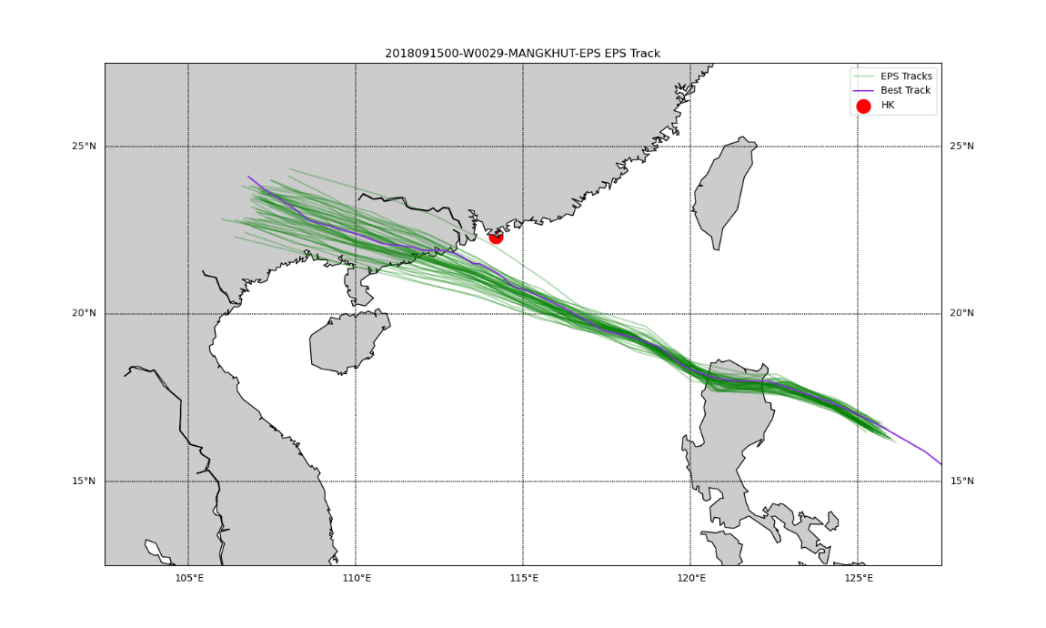
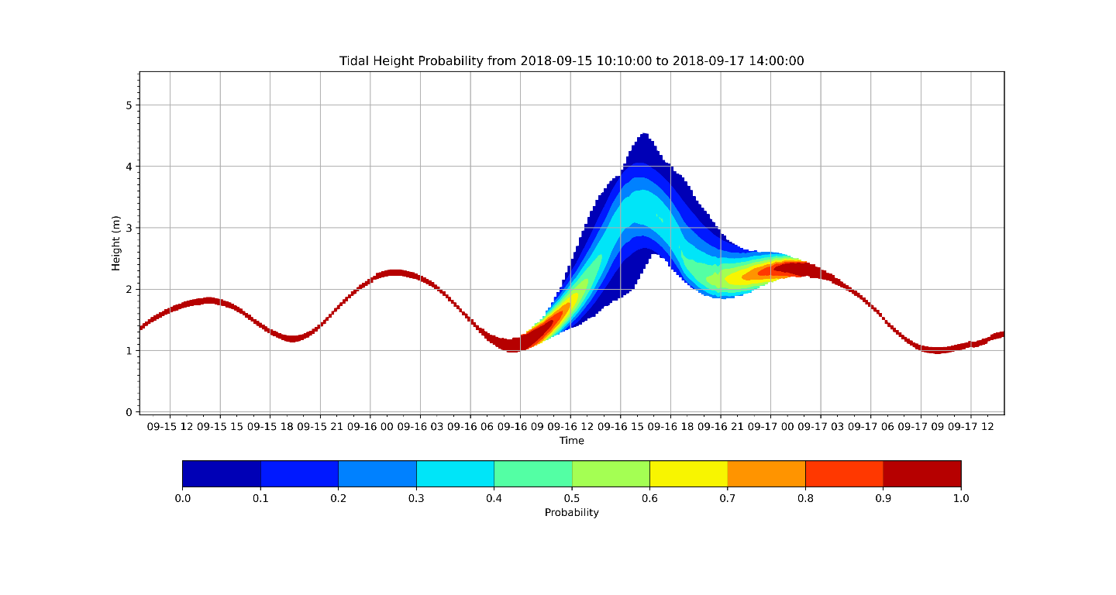
Storm Surge Probabilistic Forecast
Ensemble Approach
Ensemble Approach
Uses the tropical cyclone tracks from the 51 ensemble members of the ECWMF Ensemble Prediction System (EPS)
Takes into account the effects of atmospheric environmental changes on tropical cyclones
Risk assessment products for storm surge

Slide 20
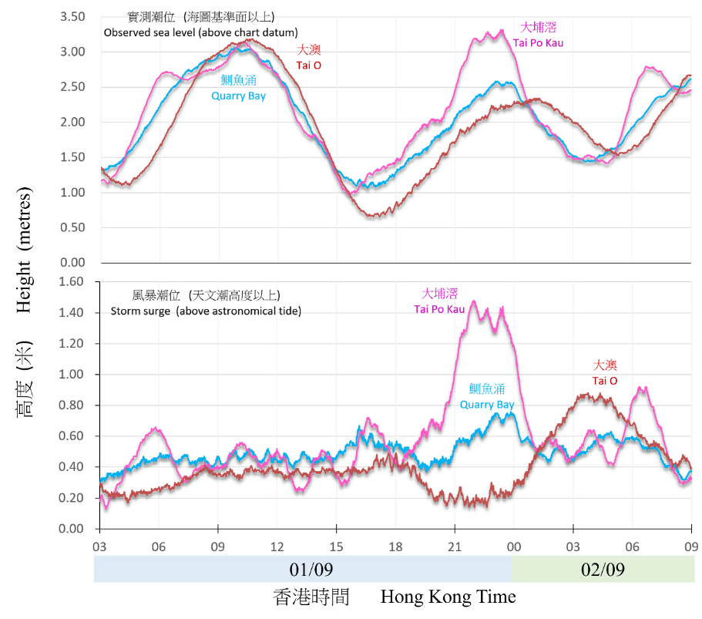
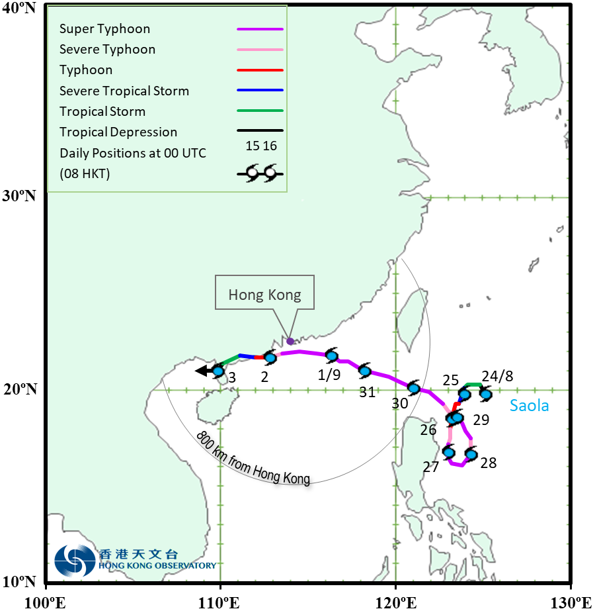
Example: super typhoon saola
Provisional track
Flooding of Shing Mun River due to storm surge induced by Saola (Courtesy of Poon Chi Ming)

Slide 21
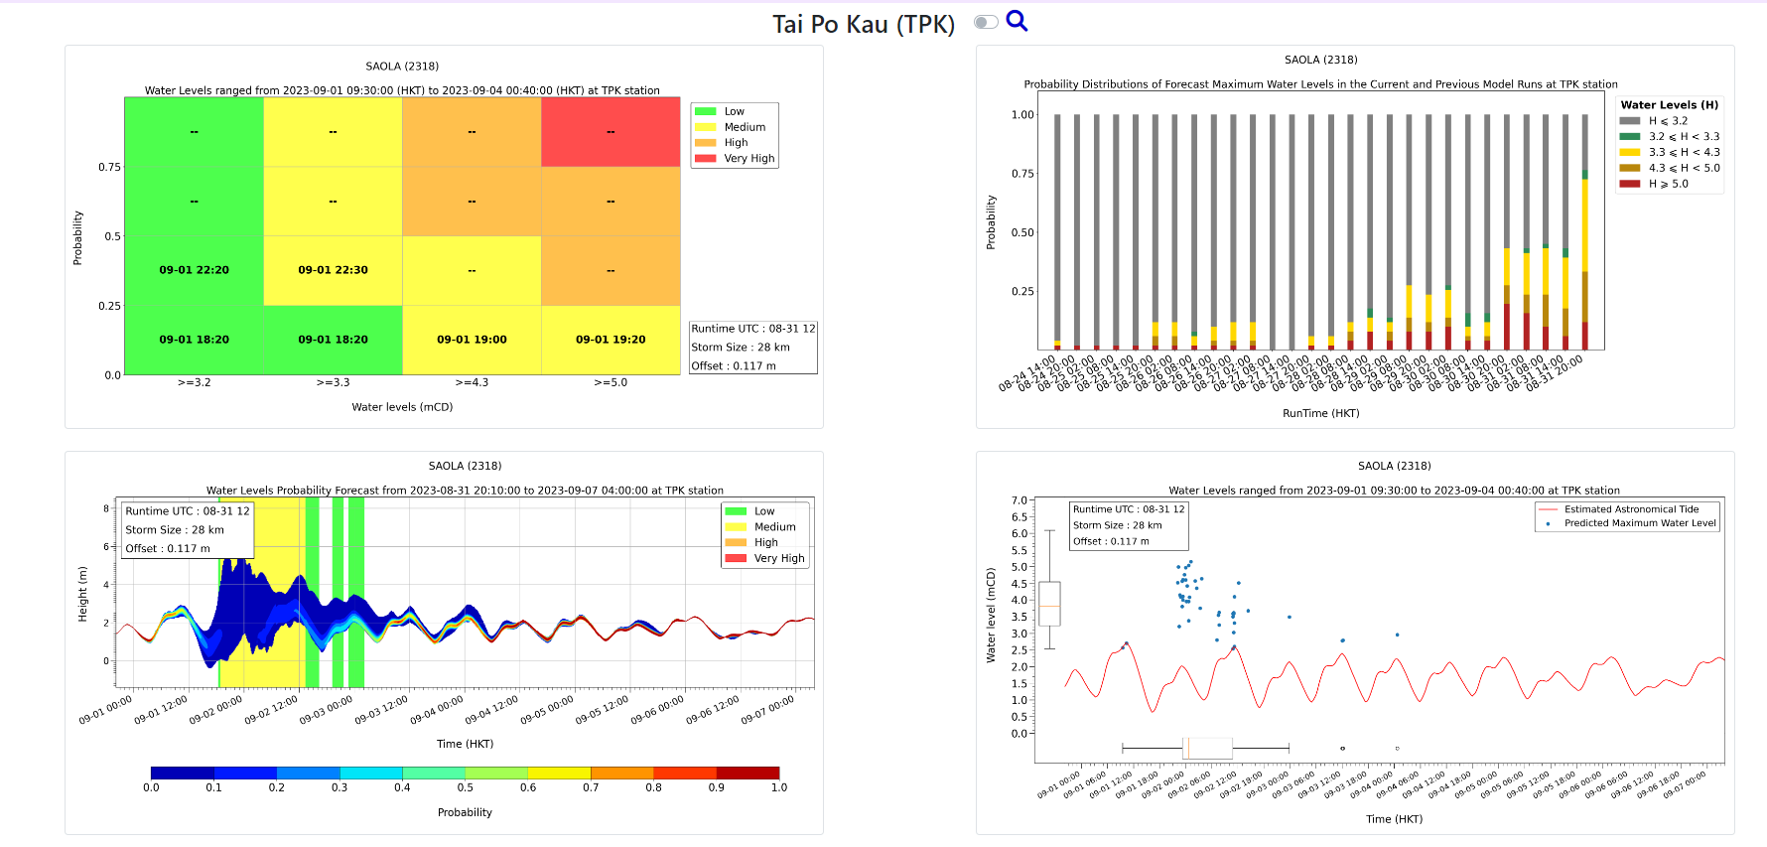
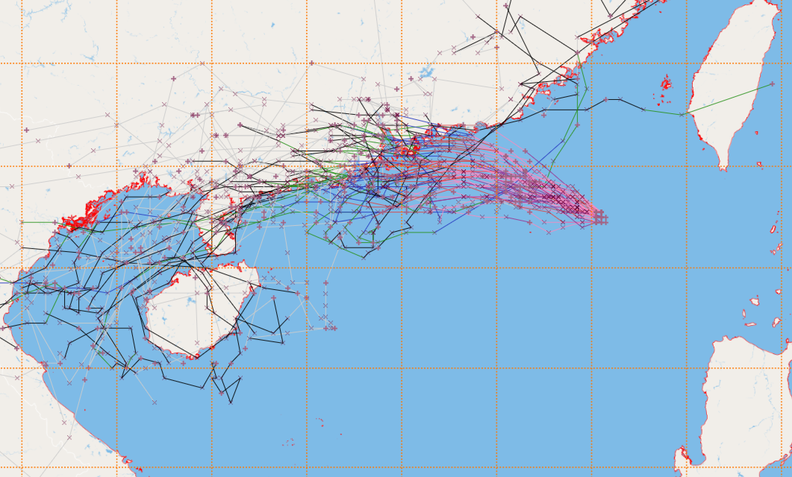
risk-based products: super typhoon saola
Making use of the risk matrix, the Probability (likelihood) and tidal level (impact) thresholds are user and site oriented.
Risk-based storm surge forecast products are provided to relevant government departments for trial.
2023 enhancements: Inclusion of off-sets in water levels based on regression methods to estimate the effect of other meteorological factors (such as monsoon) on water level
1 day before closest approach
ECMWF EPS Ensemble Tracks for TC Saola (00Z run 31 Aug 2023)

